Slide 1
Stackabilization
Honghua Li, Ibraheem Alhashim,
Hao Zhang, Ariel Shamir, Daniel Cohen-Or

Slide 2
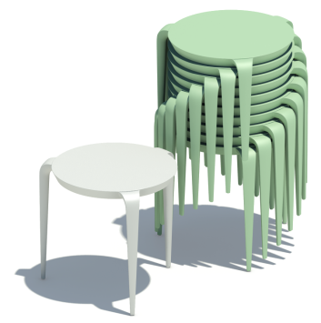
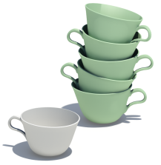
Stacking
Notes:
Stacking is a good strategy for space saving in our life . Imagine there are a set of cups in your kitchen and your storage is small. The best choice is to stack them, that can save you a lot of space.
Another example is to stack tables for shipping or storing.

Slide 3
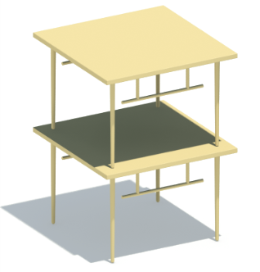
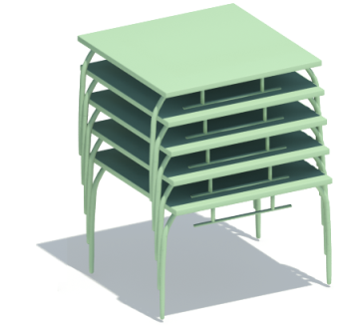
Goal: stackabilize shapes
Notes:
However, not every object is designed to be stackable. For example, to stack this table cannot save you any space.
Instead of asking engineers to redesign the shape to make it stackable, our work takes the unstackable shape as the input, and automatically convert it into a stackable version.
We can see that within the same space, now we can store 5 of the new generated tables instead of 2 of the original tables.

Slide 4
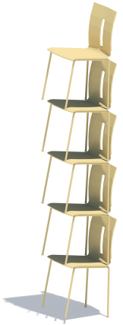
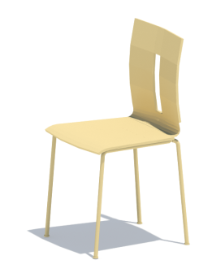
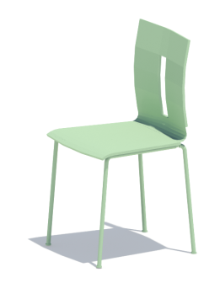
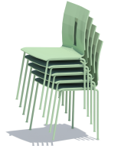
Challenge-1 geometrically understand stacking
Notes:
There are two challenges in our way.
The first is to geometrically understand stacking of shapes. Let’s take a look at these two chairs. They are very similar. However, if you stack them, you will get very different results.
The chair on the right can be stacked much more compact, such that save a lot space for you.
So the challenge is really to understand why subtle difference on the shapes can influence stacking so much.

Slide 5
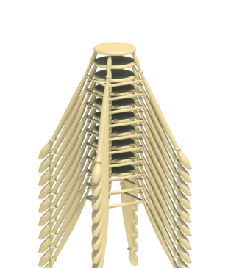
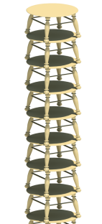
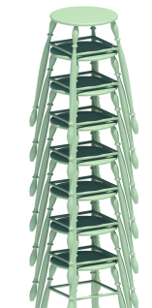
Challenge-2 space saving vs. shape preserving
Original
Squeezed
Cone-like
Balanced ?
Notes:
The second challenge is from the fact that we want to preserve the shape as much as possible when making them more stackable.
Given the unstackable stool, simply squeezing it may allow us to store more shapes within the same space. But its functionality has almost been destroyed. Another idea might be stretching the legs a lot to make it cone-like, but this introduced huge shape distortion.
A more balanced solution might be the one in green showed on the right.
So the challenge is to make a compromise between space saving and shape preserving.

Slide 6
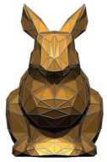
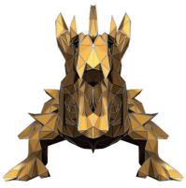
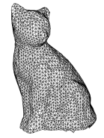
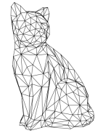
Related work
Shape optimization
Low level
High level
[Hoppe et al. 1993]
[Mitra et al. 2007]
Notes:
Our work is related to shape optimization. For early researches, shape optimization focused more on low level geometry properties, like the quality of the surface tessellations. Recently people start to optimize high level geometry properties, like symmetries.
Our work is to optimize the stackability, which is also a high level geometry property. But it’s a bit different because stackability considers the relation between the shape and its copies, rather than just the shape itself.

Slide 7
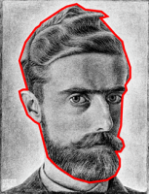
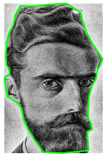
Related work
2D Tiling
Escherization
[Kaplan and Salesin 2000]
Notes:
Which relates our work to 2D tiling problem. One example is Escherization, where they find the polygonal boundary of an image, and optimize the polygon to make into match itself such that the entire 2D plane can be covered by repeating this image.

Slide 8
Our approach
Define stackability measure
Automatically improve stackability
Contact driven deformation
Structure preserving
Greedy optimization
Allow designers to control the process
Notes:
Our approach starts by mathematically defining the stackability measure. With the measure defined, we apply shape deformation to improve the stackability. The deformation model is contact driven, structure preserving and the optimization is carried out in a greedy manner. Our implementation can also allow the designers to take control of the process to improve stackability.

Slide 9
Stackability
Notes:
First let us take a look at our stackability measure.

Slide 10
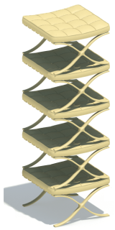
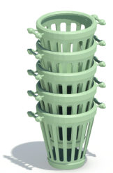
The measure
high
medium
low
Notes:
We want a measure that can distinguish these examples.
The chairs on the left can be stacked very compact and should have a high stackability. The bucket in the middle should have a medium stackability and the seat on the right should has very low stackability.

Slide 11
Stacking measure
$$>$$
$$d$$
$$d=0$$
$$h$$
$$h$$
Notes:
Given an object with a height h, and one copy of the shape. Now let us stack them. The more they get into each other, the more stackable the shape should be. Here is a different wine glass, when stacking its two copies, they cannot get into each other at all.
Obviously the wine glass on the left should has a higher stackability.

Slide 12
Stacking measure
$$S=\frac{d}{h}$$
$$d$$
$$h$$
Notes:
So we can simply define the stackability as the ratio between the amount of vertical overlapping and its height.

Slide 13
Stacking measure
$$S=\frac{d}{h}$$
$$S=1−\frac{g}{h}$$
$$d$$
$$h$$
offset
$$g$$
Notes:
Instead of computing the vertical overlapping d, we figured out its complement, the offset g, is more easier to compute.
Then stackability measure then becomes one minus the ratio between the offset of the height.

Slide 14
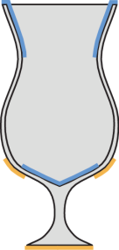
Upper & Lower Envelopes
Upper envelope
Lower envelope
Notes:
To compute the offset g, we define the upper and lower envelopes of the shape. The upper envelope is part of the shape that can be seen from the top and the lower envelope is that from the bottom.

Slide 15
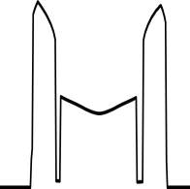
Gap function
Gap function$f$
Notes:
These two envelopes can be regarded as two functions and we call the difference between these two functions the gap function.
We are interested in this gap function just because….

Slide 16
Gap function
$$S=1−\frac{f_{max}}{h}$$
$$g=f_{max}$$
$$d$$
$$h$$
offset
$$g$$
$$f_{max}$$
Notes:
… its maximum is exactly the offset that used to define the stackability measure.
Since the gap function can be efficiently computed, the computation of stackability is easy.

Slide 17
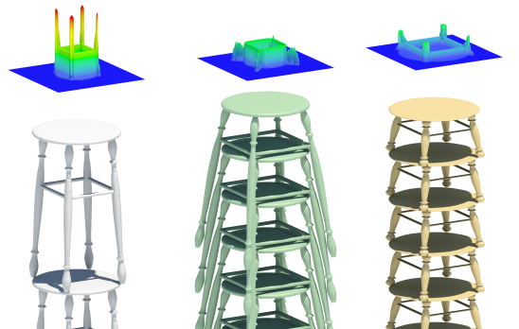
Gap function
$$f_{max}$$
$$f_{max}$$
$$f_{max}$$
$$g=f_{max}$$
Notes:
Here are more 3d examples of the gap functions, whose maximum is exactly the offset of two copies when you are stacking objects.

Slide 18
Improve stackability
Notes:
Have defined the stackability, the next task is to figure out how to improve the stackability of a given shape.

Slide 19
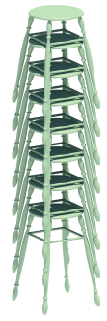
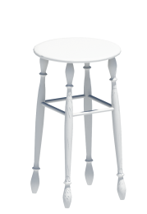
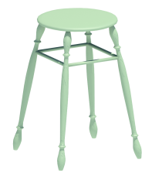
Slight shape changes
$$S=0.0$$
$$S=0.7$$
Notes:
Given this stool whose stackability is 0, we slightly change the shape by pulling its legs apart, and the resulted stool has a stackability of 0.7.
To find out why this slight shape changes can caused such a big change of the stackability,

Slide 20
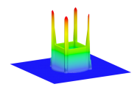
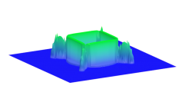
Slight shape changes
Gap function
$$S=1−\frac{f_{max}}{h}$$
Notes:
We examined their gap functions, and we noticed their maximum changed dramatically, resulting a big change of the stackability.

Slide 21
Slight shape changes
$$Δf_{max}$$
$$S=1−\frac{f_{max}}{h}$$
Notes:
Now we see slight shape changes can change the maximum of the gap functions a lot.
But not every shape changes can changes the f_max a lot.
For example, if we move the horizontal bar of the stool vertically, the gap functions will be changed but its maximum doesn’t change too much.
If we compare these two cases, the difference is the location where the shape changes happens.
If the location is around the area where the maximum of the gap function occurs, like the case on the left, we are more likely to change the stackability a lot.

Slide 22
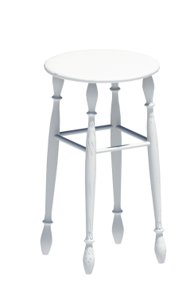
Interesting shape changes
Notes:
This inspires us to focus on the shape changes that around the area where the maximum of the gap functions occurs.

Slide 23
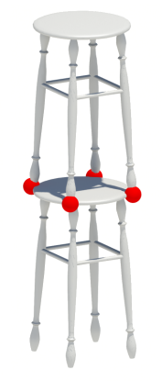
Contact regions
Notes:
Which we call contact regions. For example, the contact regions are at the end of the legs of this tool.

Slide 24
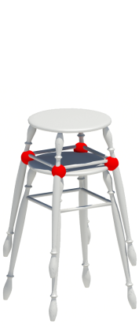
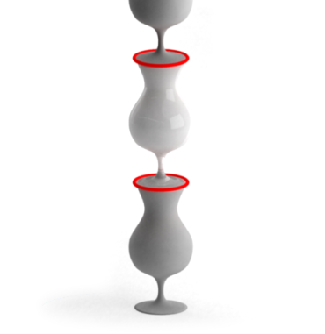
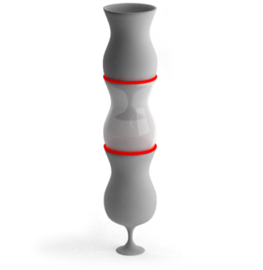
Contact driven deformation
Notes:
By treating contact regions as handles, we call our deformation model the contact driven deformation.
Now moving the handles outward can improve the stackability.
For the wine glass, the contact region is at its rim. By opening the ring handle, the stackability is also improved.

Slide 25
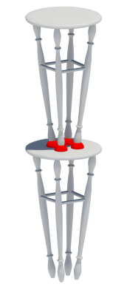
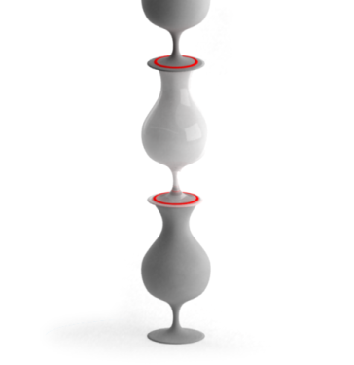
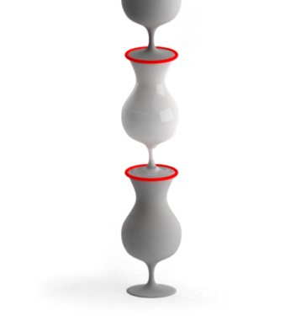
Contact driven deformation
Notes:
But we need to search for the best direction to move the handle.
For example, if we move the handle inward, the stackability is not going to be improved.
Similarly we cannot shrink the rim of the wine glass to improve the stackability.
Now let Ibraheem to present our algorithm and implementations.

Slide 26
Algorithm
Notes:
Howard has showed us how small changes at contact regions dramatically affect the stackability
If you recall the second challenge was finding shape deformations that do not distort the model’s shape and structure while increasing stackability
This objective is the basis of our optimization process

Slide 27
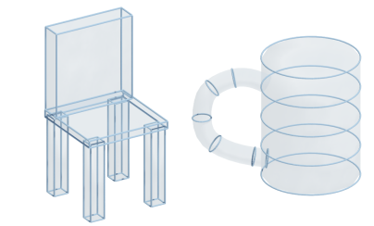
Deformation model
Component-wise controller [Zheng et al. 2011]
Cuboid
Cylinder
Generalized Cylinder
Notes:
We employ a deformation process based on the recent work of component-wise controllers
Using controllers, as opposed to basic vertex movements, helps avoid cascading distortions to the shape while its becoming more stackable
For different parts, we use [#] cuboids, [#] cylinders and [#] generalized cylinders
The type of controller is selected based on the nature of the underlying part or a desired level of its flexibility

Slide 28
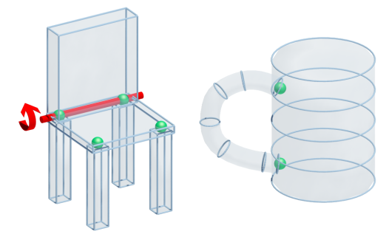
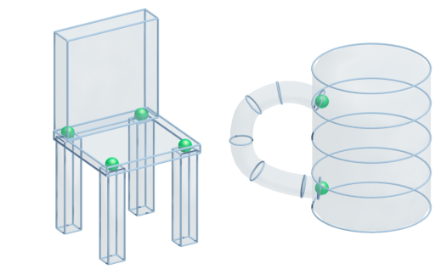
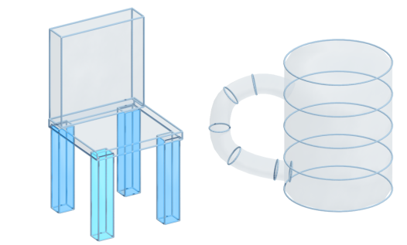
Deformation model
Structure preserving
Symmetries
Point joints
Line joints
Notes:
The structure of the shape is better preserved when we take into account relations between these controllers
That is why we consider symmetries.. and proximity relations defined as point joints and line joints, depending on the relation of two parts
For example, legs are joined with the chair’s seat with point joints….. And the seat and back of the chair use line joints

Slide 29
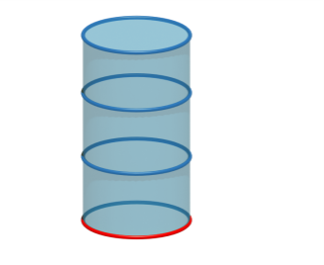
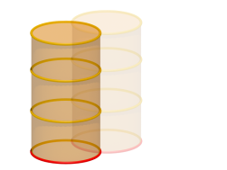
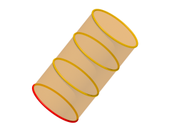
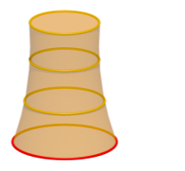
Optimization problem
Search space is huge
Translation
Rotation
Scaling
Controller
Notes:
Each controller is composed of several sub-parts called curves that act as a type of handle for the part
Beside transforming the entire controller, the curves themselves can translate, rotate, or scale resulting in a large search space when considering all the different allowed deformations

Slide 30
Optimization problem
Find the best shape deformation
Improves the stackability
Preserves shape structure and minimizes distortion
Shape distortion
Stackability improved
Notes:
In order to bring the complexity of the problem to a manageable level, we defined an objective where the best shape deformation is the one that improves the stackability [#] and at the same time minimizes the shape’s distortion [#]
The details of which can be found in the paper

Slide 31
Optimization
Greedy approach
Input
Target stackability
Best candidate
Target is met?
Yes
Output
Candidates
Contact driven deformation
No
Notes:
Our optimization process is greedy
Given a shape and a user specified target stackability level
It iteratively selects the best candidate from a pool of candidates and checks whether the stackability measure has been met
If not, the contact driven deformation process selects the appropriate deformation handle based on the current contact region and generates a set of candidates that are added back to the pool
This process iterates until the target is reached or no allowed deformations can increase the current stackability level

Slide 32
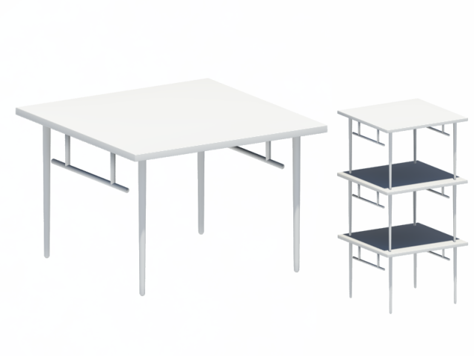
Optimization
Notes:
Here, I’ll present a full example of how the process works when stackablizing this table
As we can see, the initial shape is not space saving when using translational stacking along the upright direction

Slide 33
Optimization
Notes:
Once the different parts are fitted with the appropriate controllers and the different relations have been extracted
The optimization process selects the appropriate handle, in this case the last curve of the leg, and applies different deformations
The best option, as defined by the our objective, is then applied

Slide 34
Optimization
Notes:
Once the different parts are fitted with the appropriate controllers and the different relations have been extracted
The optimization process selects the appropriate handle, in this case the last curve of the leg, and applies different deformations
The best option, as defined by the our objective, is then applied

Slide 35
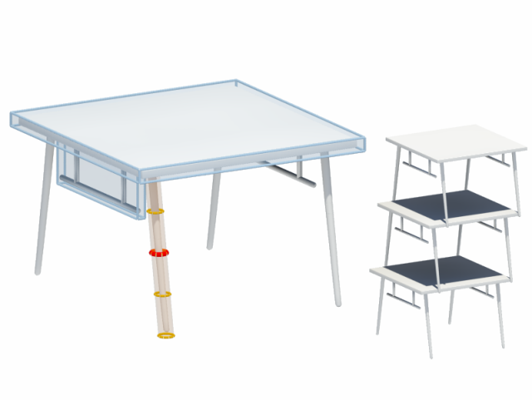
Optimization
Notes:
At this point, the contact region has changed into the middle part of the leg
The best deformation is again selected

Slide 36
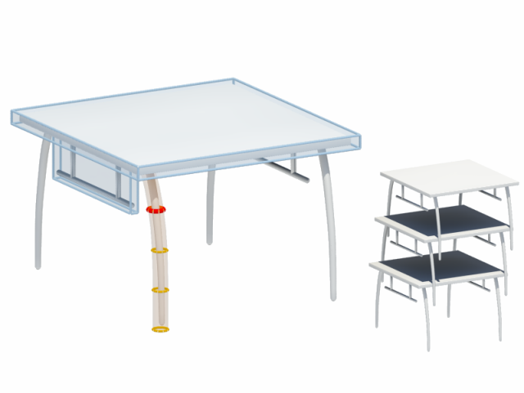
Optimization
Notes:
And the process continues

Slide 37
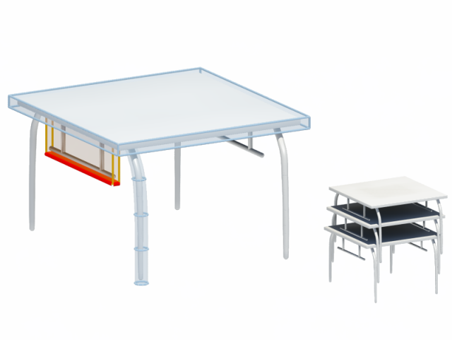
Optimization
Notes:
The contact region may change to other controllers of the shape
but the process remains the same and the best deformation of that part is applied

Slide 38
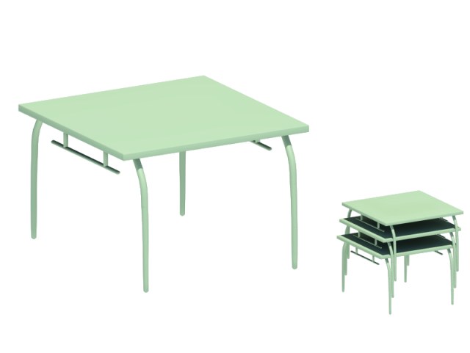
Optimization
Notes:
Once the target stackability is met, the table can now be stacked while saving much more space and its overall shape preserved

Slide 39
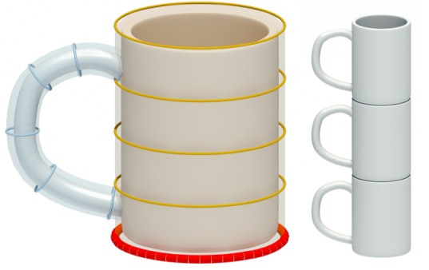
Optimization
Notes:
Here, we show another example of a coffee mug initially having bad stackability
The contact driven deformation generates different choices and the best one is selected

Slide 40
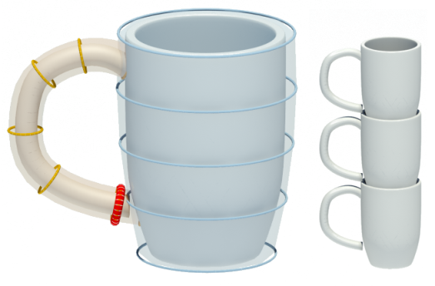
Optimization
Notes:
The stackability has slightly increased, and the contact region has changed

Slide 41
Optimization
Notes:
With the presence of the cup’s handle the process seem to alternate between shrinking the bottom of the cup and..

Slide 42
Optimization
Notes:
moving the handle upwards

Slide 43
Optimization
Notes:
Here is the final result with the user defined target is met

Slide 44
Implementation
Notes:
We have implemented a proof-of-concept tool that applies the stackabilization process to 3D models
For each model loaded we assume it is well segmented, and assume the user assists in the controller fitting process on the different parts

Slide 45
Prerequisites
Segmentation and Controllers
Cuboid
Generalized Cylinder
Notes:
The primitive fitting process also affects the behavior of the deformation
We can see that by using the more rigid cuboid controllers for the legs we scarified the width of the original table, where as using the more flexible generalized cylinder kept the table top intact
In our implementation we relay on the user’s assistance for the choice of controllers. In practice this is achieved with simple clicks on the parts
We think this prerequisite can be incorporated in the search process

Slide 46
Prerequisites
Symmetry and joint detection
Notes:
As part of the input, we also need to extract part relations
In our implementation we analyze the intersection of the parts in order to classify the joints
Symmetry relations at the current implementation is manually defined
But we also think that its possible to automate this task

Slide 47
Results
Notes:
We now show more results of our stackablization tool

Slide 48
Results
Notes:
The white objects are the input shapes
The yellow stack show the best stacking possible for the input shape before the stackabilization process
The green stacks are the result of our stackablization process

Slide 49
Results
Notes:
Here we see a complex basket and a bucket

Slide 50
Results
Notes:
Different types of chairs that stack vertically or horizontally

Slide 51
Results
Notes:
Here is a table with a complex set of legs and a chair with disproportional parts

Slide 52
Conclusion, limitations and future work
Notes:
SLIENCE

Slide 53
Conclusion
Defined a measure for stackability
Analyze and optimize geometry of the shape to increase its stackability
Notes:
So, we have defined a novel measure for the stackability of the shape based on the ratio of the space saved
We also presented a simple framework to compute stackable versions of the shape by analyzing it and optimizing towards a more stackable version while preserving its shape

Slide 54
Limitation
Deformation model is limited
Notes:
Our implementation is limited by the set of allowable deformation operations defining the search space
In this swivel chair example, the algorithm stops at the shown stage in the middle with no stackability improvements.
However, a user maybe able to design the chair such that parts of the legs are elongated while others are shortened in effect increasing stackability

Slide 55
Limitation
Stability of stack
Notes:
Another challenge is not taking into account of physical constraints, such as stability [#], which can be a critical requirement in real-world applications

Slide 56
Future work
Partition + stackabilization
Notes:
We think the problem of stacking and space saving opens up several avenues for future work
One of which is the concept of coupling partitioning with stackablizing

Slide 57
Future work
Partition + stackabilization
Notes:
For example, this chair might be portioned into the seat part and the frame part, this can be the case for example if we’d like to ship a group of such a chairs in the smallest space possible
Trying to stackablize the chair as a whole might fail using our method, especially when the only solution is to distort the shape, but applying the process on the frame part…

Slide 58
Future work
Partition + stackabilization
Notes:
As seen here, we are able to save a lot of space for the entire set of chairs

Slide 59
Future work
Folding + stacking
Notes:
Another avenue for future work is extending the problem to deal with articulated shapes with parts that can be folded similar to this

Slide 60
Future work
Other deformation models
Notes:
The nature of the deformation model used in our implementation does not allow organic-like shapes to be deformed more precisely
We suspect that using surface deformation would allow the stackabilization process to handle this bottle example by deforming the base to exactly match the profile of the top part, in turn making it more stackable as seen in green
This example is not done using our method, however the same principles were used by the designer when generating the more stackable shape on the right

Slide 61
Thank you
code.google.com/p/stacker
Notes:
I hope you enjoyed the talk, thank you for your attention

